Slide 1


ABOUT VESTWOODS
LEADING GREEN TECHNOLOGY TOUCHING LIVES
YOUR ENERGY PARTNER FOR A SUSTAINABLE FUTURE
© COPYRIGHT VESTWOODS 2026

Slide 2

01
About Us

Slide 3
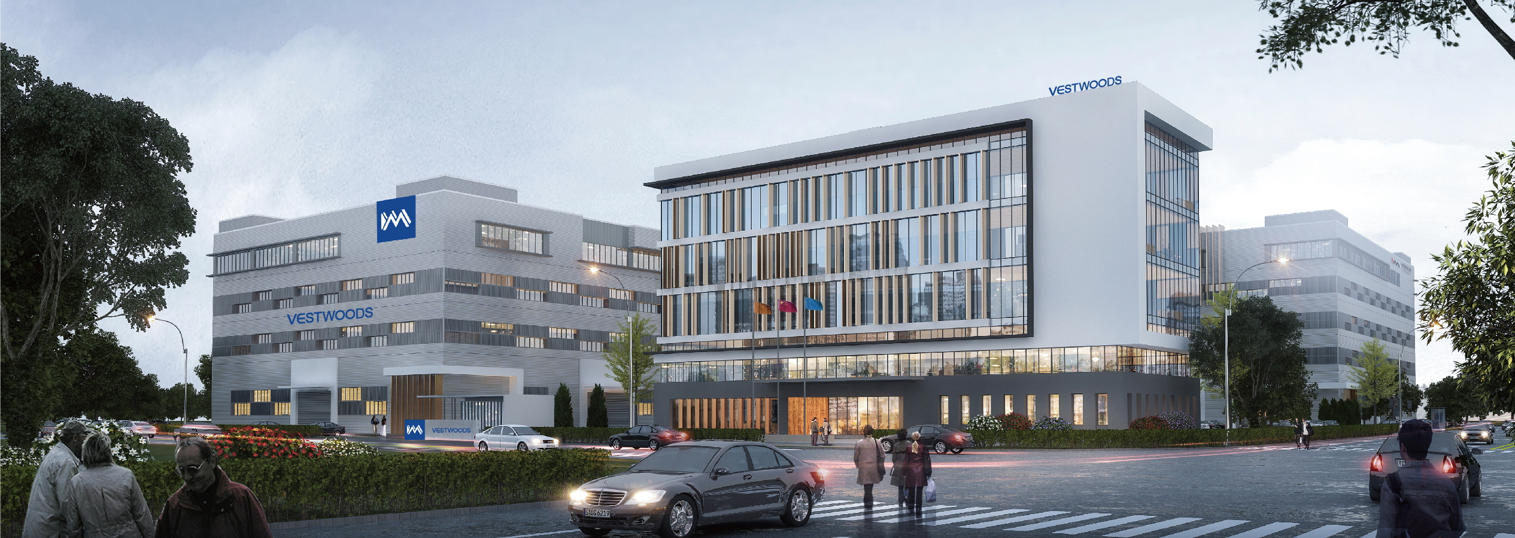
About VESTWOODS
Vestwoods Technology Co., Ltd (Haier Energy), a high-tech enterprise under Haier Group, is the only subsidiary focused on lithium battery system integration for new energy solutions. It provides green energy solutions and services to global users.
Since its establishment in 2016, VESTWOODS has quickly started with overseas business, built manufacturing bases, and gained a leading position in India's telecom backup power market, gradually expanding to Europe, Asia, Africa, and more than 50 countries worldwide. It is currently a GWh-level manufacturing base.

Slide 4
About VESTWOODS
60%
R&D as a Percentage
200+
Patents
5GWh
Annual Capacity
25,000㎡
Production area
50+
Countries and Areas
80+
Global Customers

Slide 5
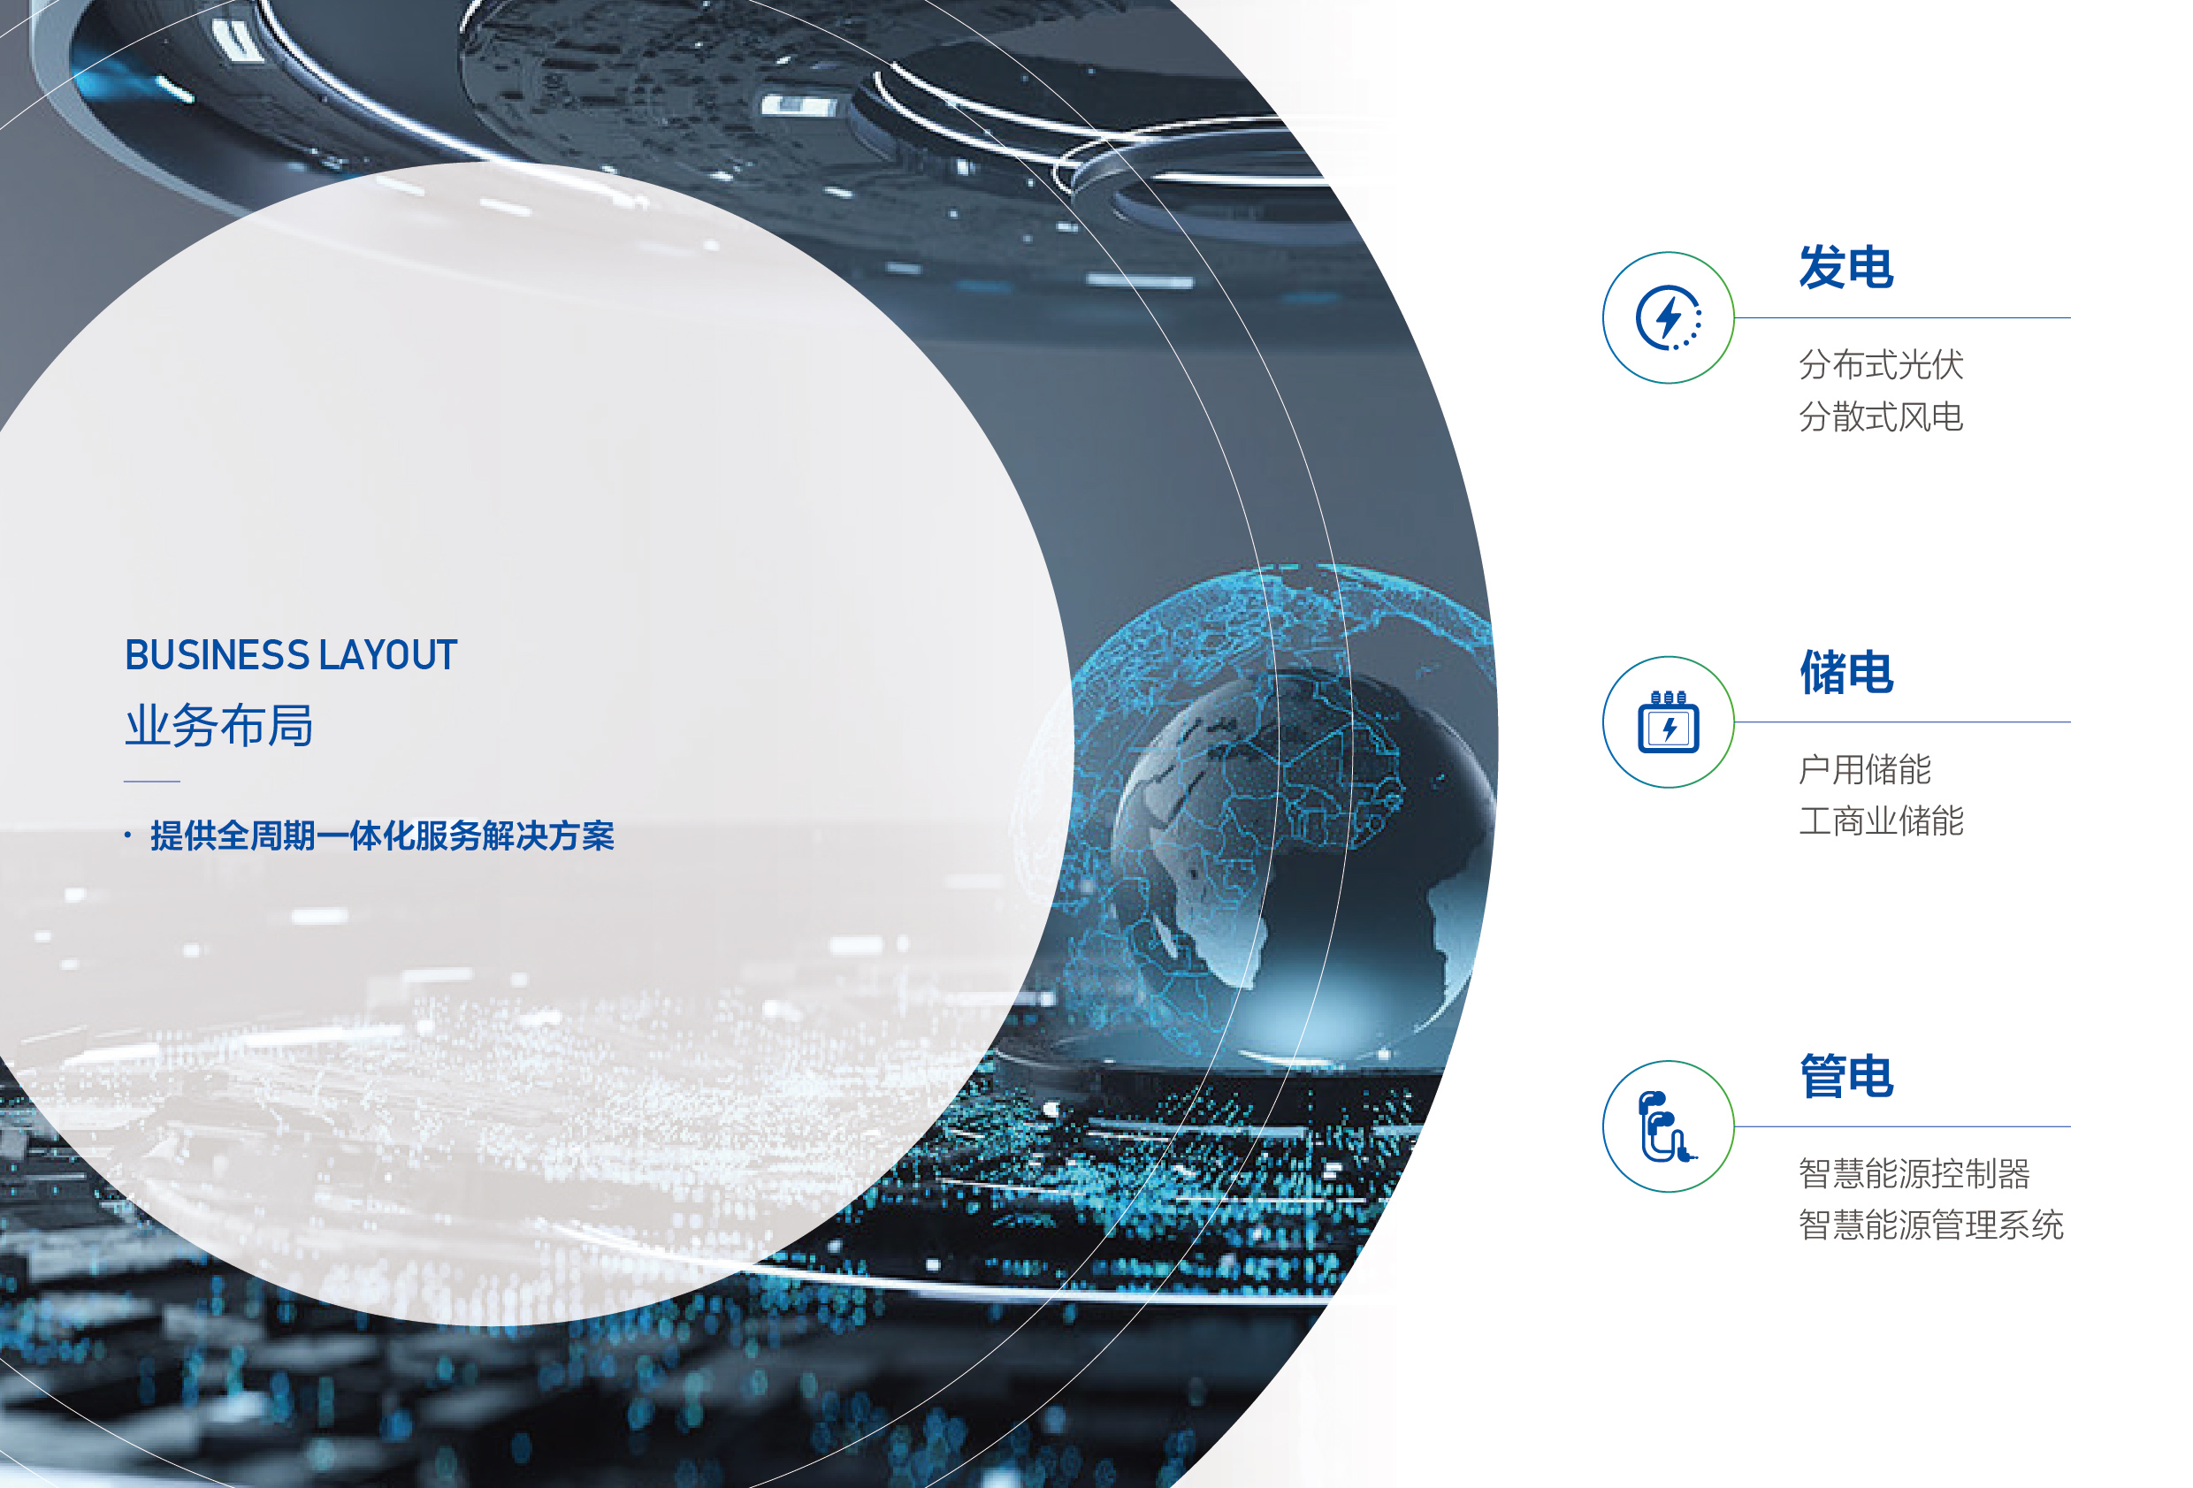
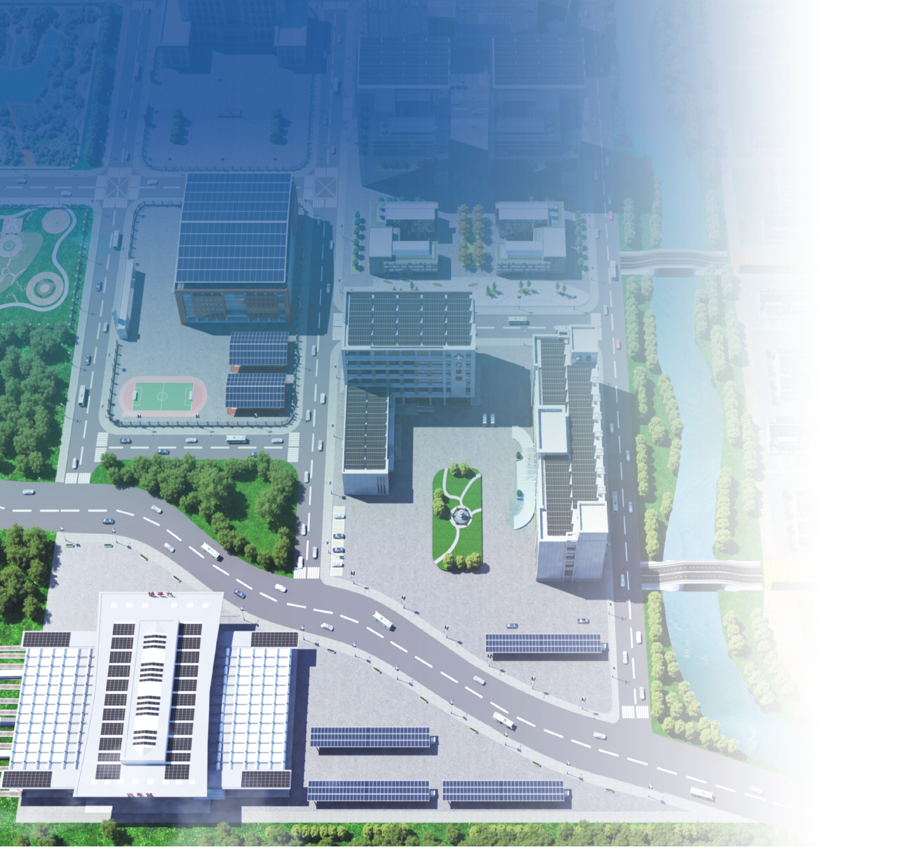
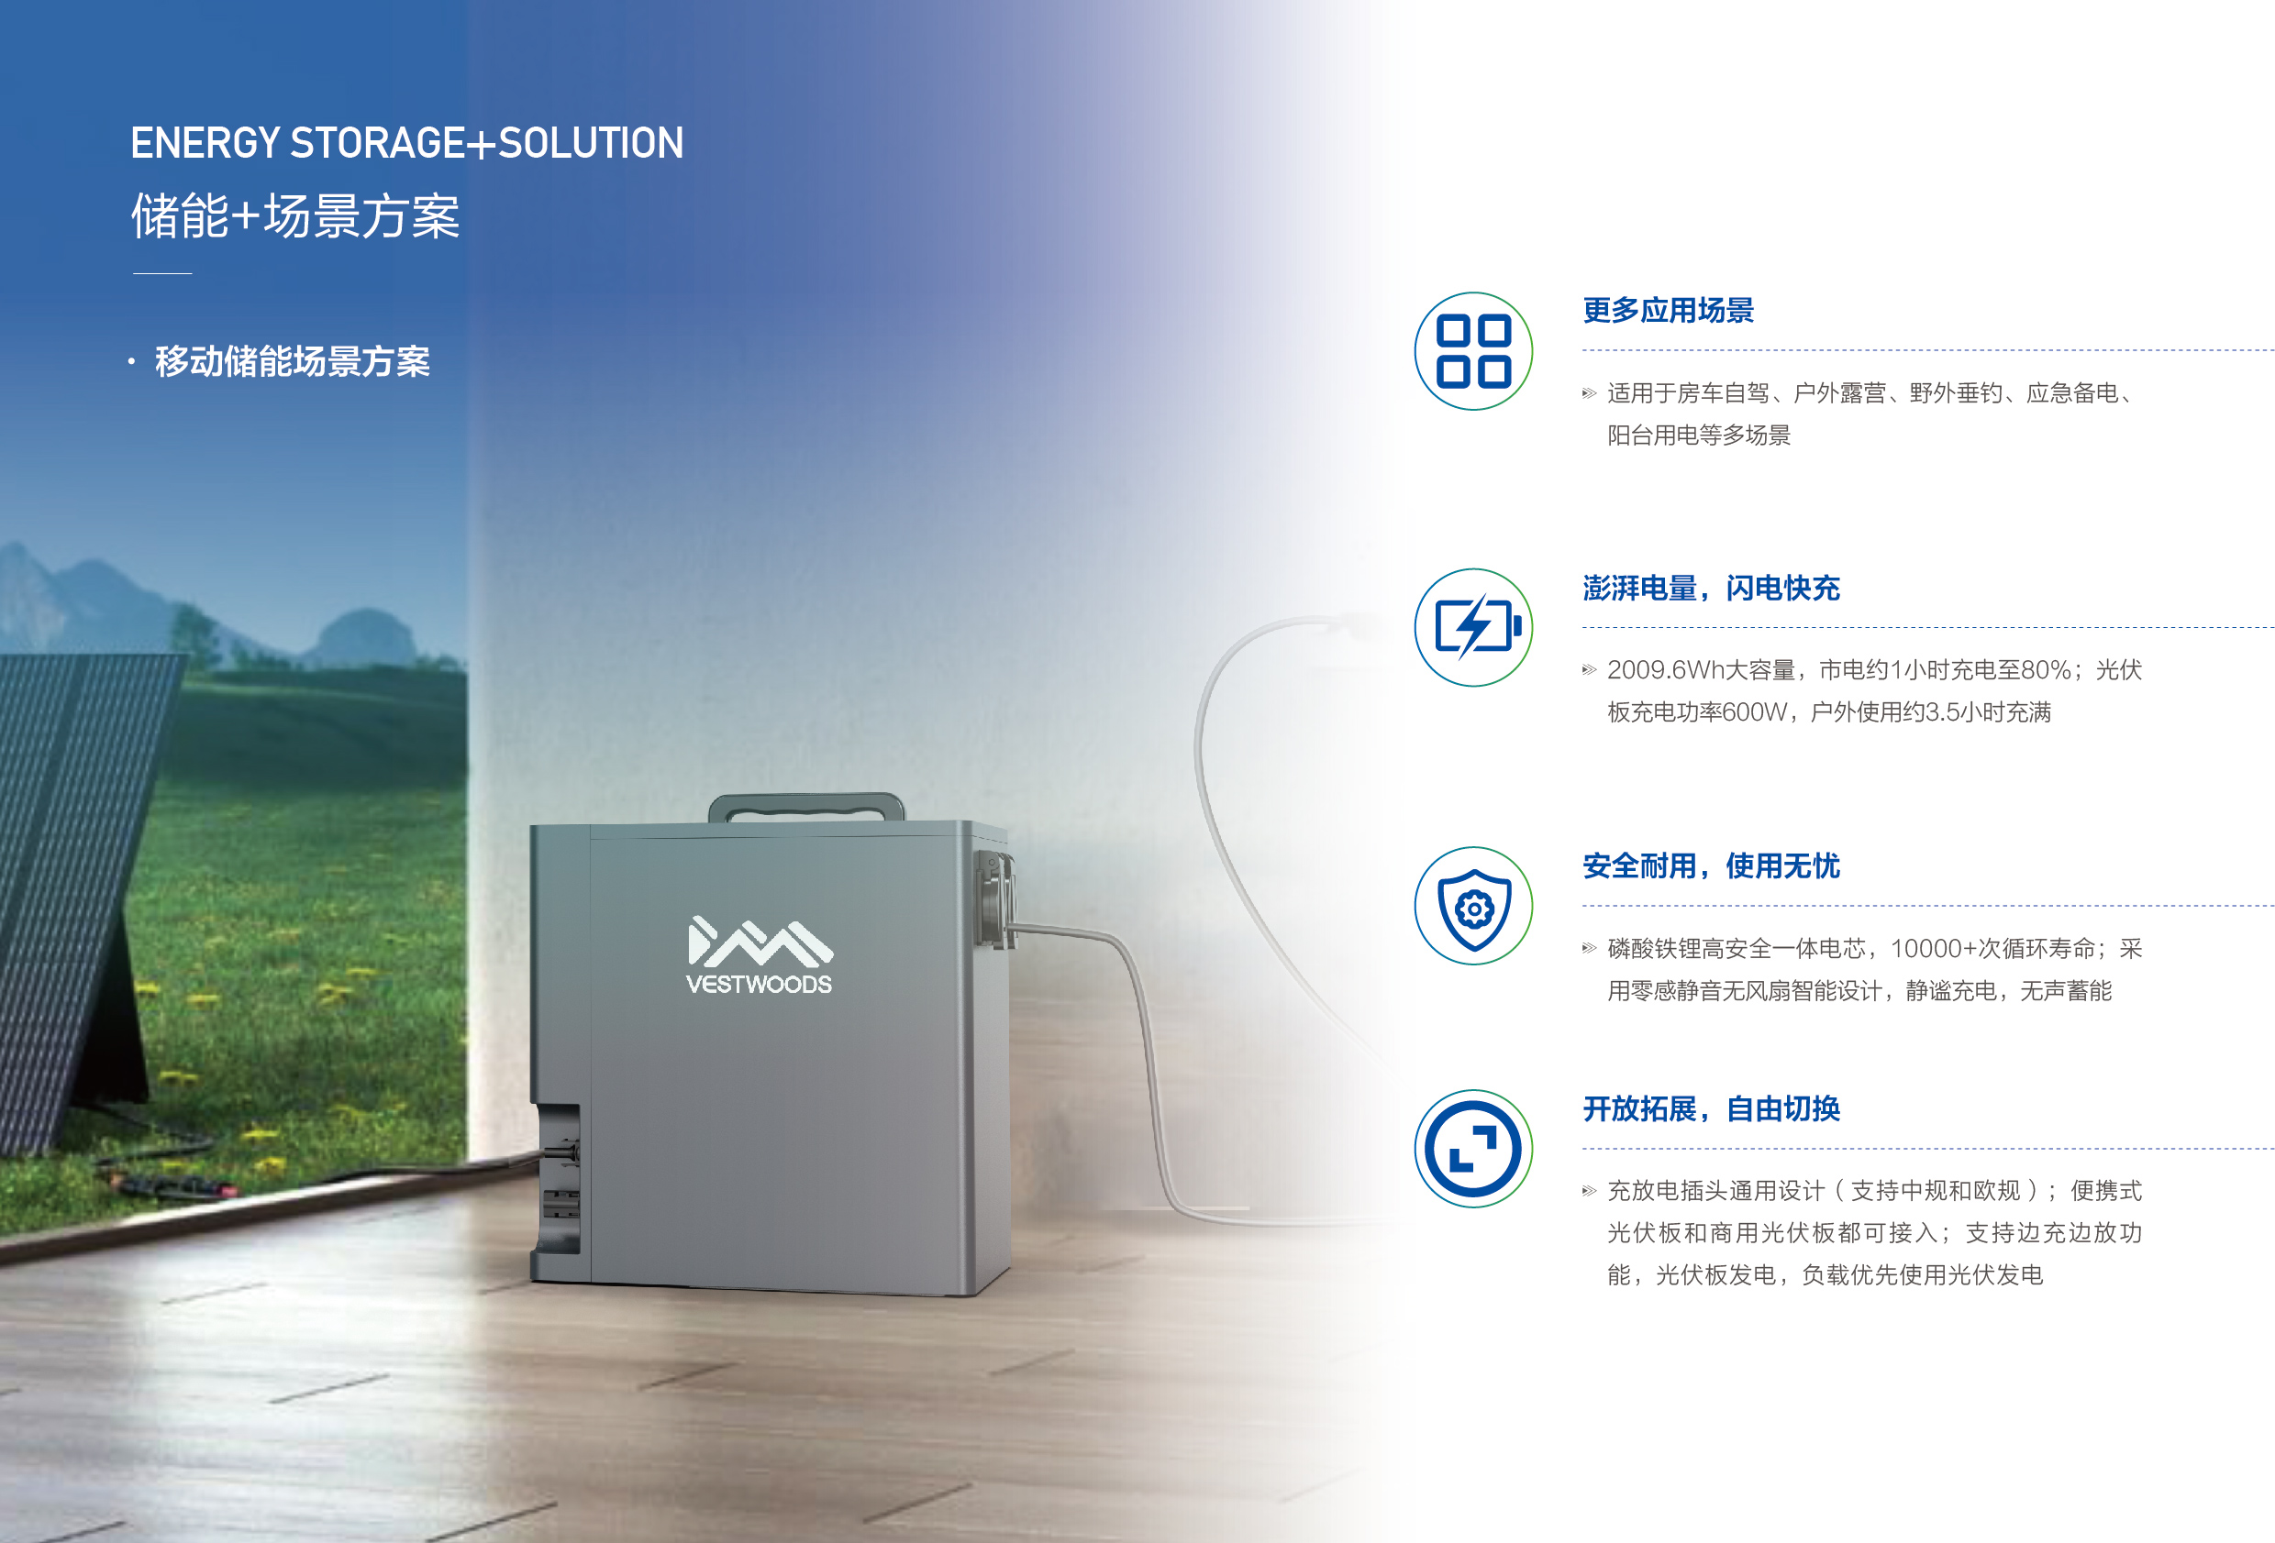
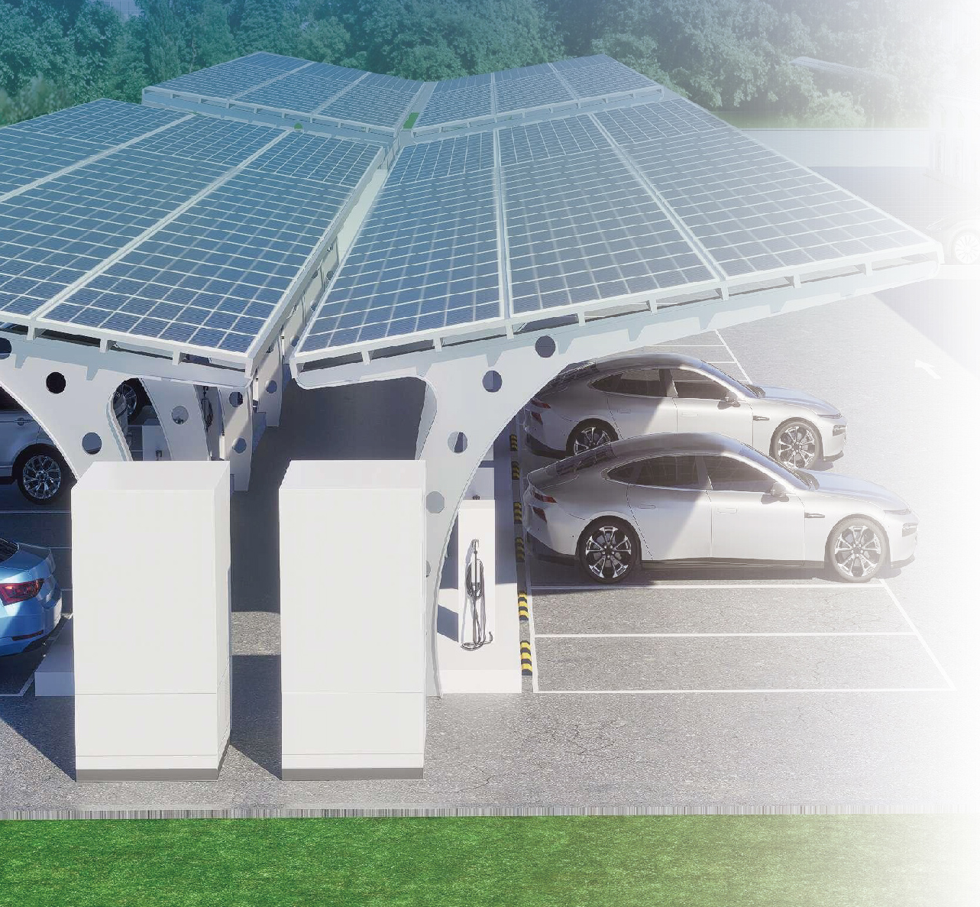
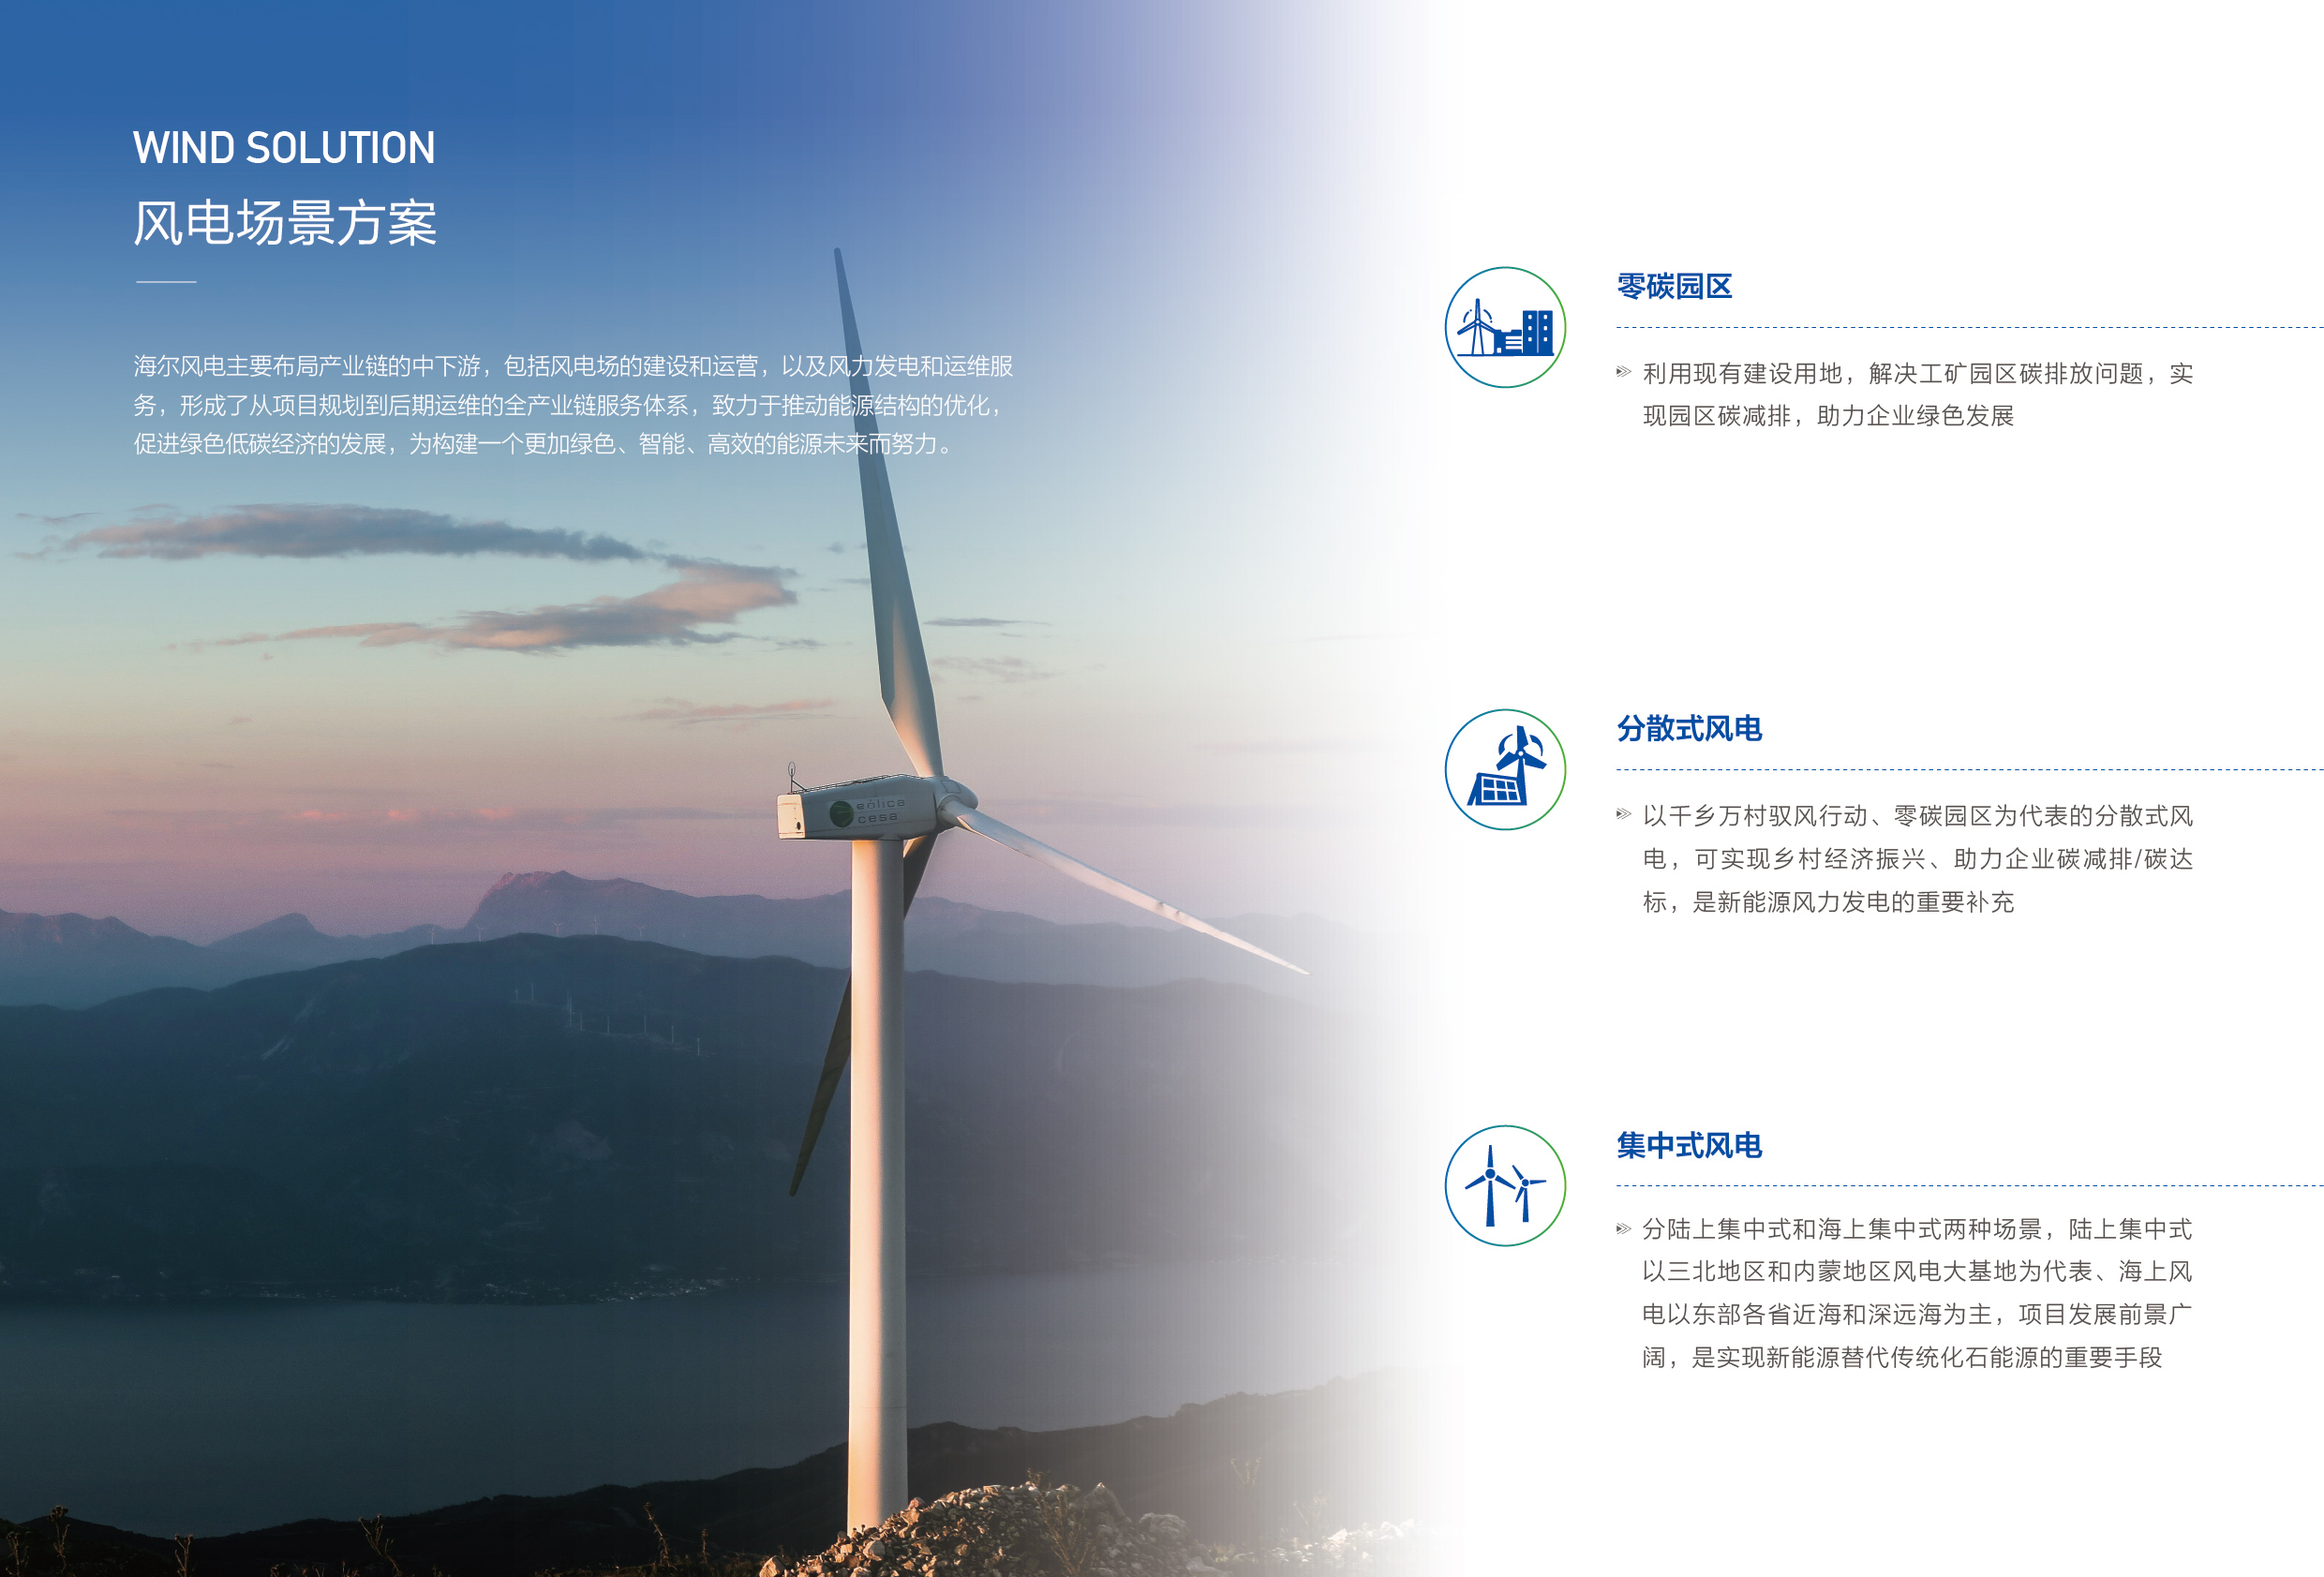
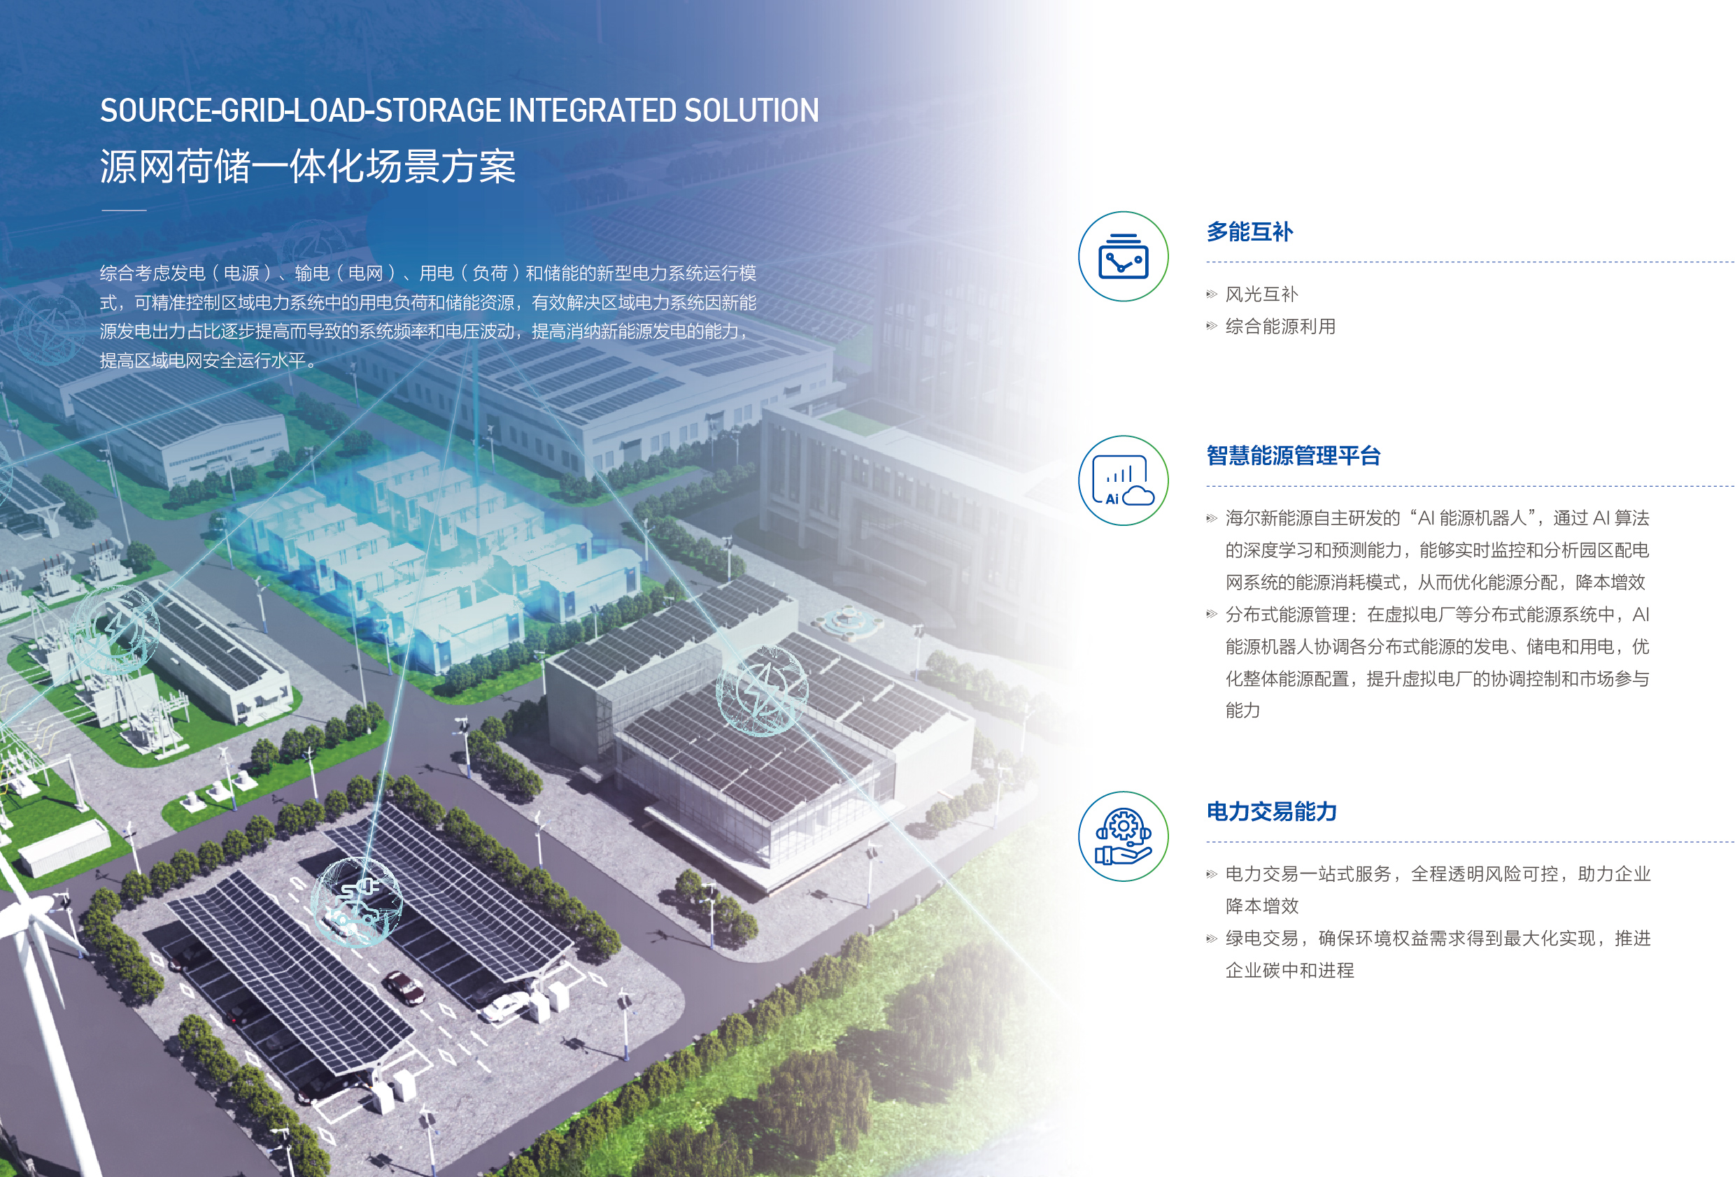
Haier Energy
Empower green development
contribute with Haier's strength
Electricity Generate
Distributed photovoltaic
Distributed wind power
Electricity Storage
Residential Energy Storage
C&I Energy Storage
Electricity Management
Smart Energy Controller
Smart Energy Management System
Haier Energy, focuses on three major industries: distributed green energy, user-side energy storage, and smart energy controllers. Through intelligent integration of software and hardware, it provides smart clean energy solutions for households and commercial users, aiming to become a global leader in distributed smart clean energy solutions.
It’s user experience-centered, focused on providing domestic and international households, commercial, and industrial users with solutions in distributed photovoltaics, decentralized wind power, and integrated solar and energy storage across all domains and scenarios.
Photovoltaic+Solution Energy storage+Solution Light storage+Solution Wind Solution Source-Grid-Load-Storage
integrated solution

Slide 6
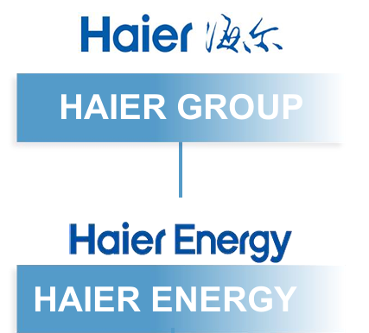
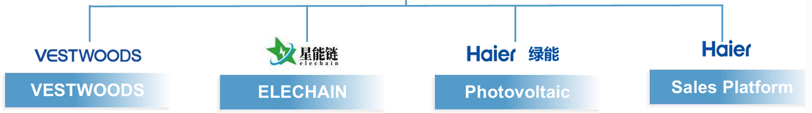

Haier Energy
Haier New Energy Business Layout and Synergy
Vestwoods: Energy storage business
covering the Middle East and Africa,
providing integrated services from sales to
equipment supply, installation, and
operation & maintenance, enhancing local
power system reliability.
ELEC: Provider of inverters and
PCS equipment, supplying core
devices for global energy projects.
Green Energy: Photovoltaic business
covering the Southeast Asia region,
responsible for project sales, equipment
supply, implementation, and operation &
maintenance management, promoting
regional sustainable energy development.
Sales Platform: Covering South Asia
and Europe markets, connecting
products with customers, and
promoting localized sales and services
of global energy products.

Slide 7
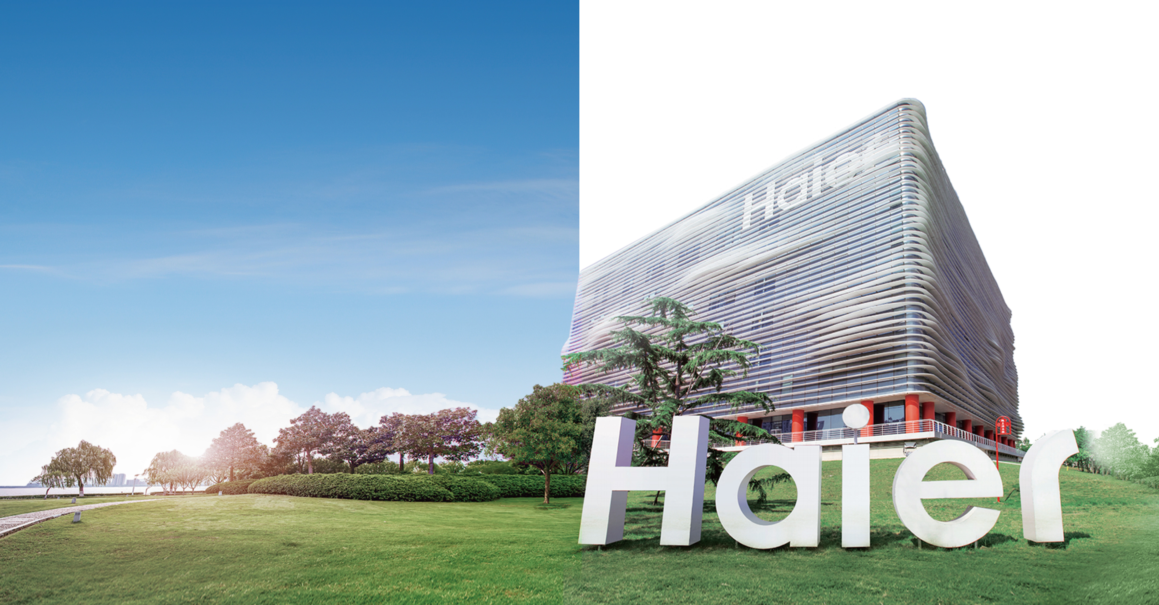

About Haier Group
Haier Group, as a world-leading service provider of better life and digital transformation solutions, has always been user-centered. It leverages technological innovation to customize smart lives for global users, con- tributing to the high-quality and sustainable development of the econo- my and society.
For six consecutive years, it has remained in the "BrandZ Top 100 Most Valuable Global Brands“ as the world's only loT ecosystem brand.
6 years
100
top
The only IoT ecosystem in the
World for six consecutive years
Retain its position in the “BrandZ Top 100 Most Valuable Global Brands”
#1
143+
200+
Globally in Major Appliances
Manufacturing centers
Countries & Regions
48.1 B€
1 BILLION
Operating Revenue
User families

Slide 8
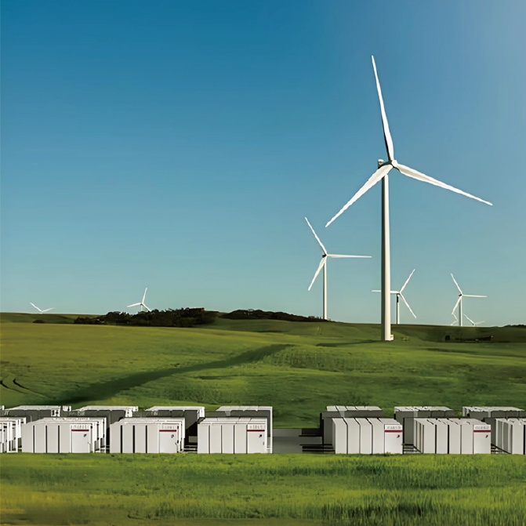
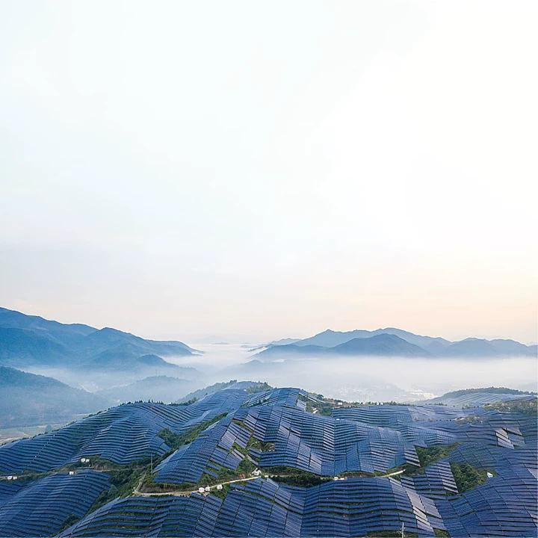
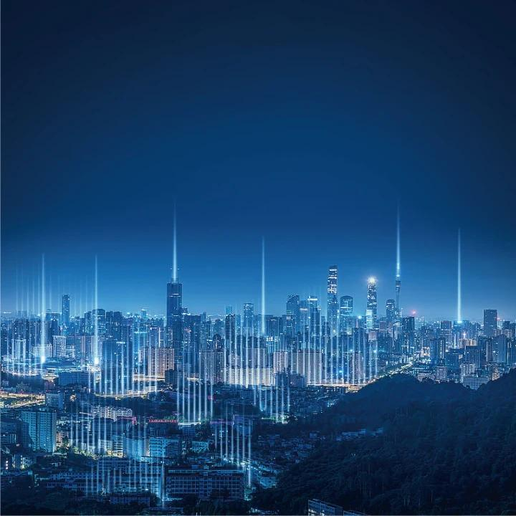

VESTWOODS Brand Significance
GREEN
ECO-SYSTEM
INTELLIGENCE
COLLABORATION
Pioneering innovative clean energy technologies, we lead the transition to a zero-carbon era. Together, we are committed to safeguarding our planet’s green homeland.
Guided by our "Borderless Ecosystem" philosophy, we synergize the innovation, capital, and supply chains to drive integrated development. By fostering collaboration across industrial ecosys- tems and enabling shared prosperity within the energy sector, we aim to establish a globally leading distributed smart energy ecosystem.
As a premier provider of distributed intelligent clean energy solutions, we leverage smart energy systems to protect and enhance sustainable living environments.
With Users: Delivering green, low-car- bon, and intelligent lifestyles through innovative partnerships.
With Partners:Creating measurable economic value and amplifying positive impacts across the energy ecosystem.

Slide 9



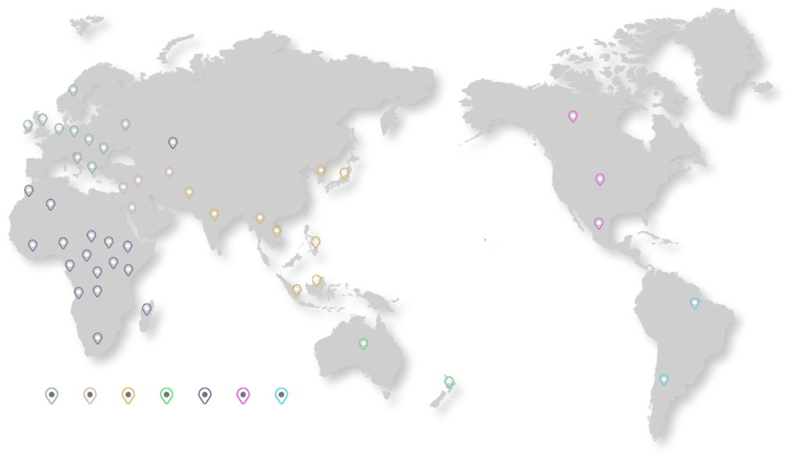













VESTWOODS Leading Marketing share
Telecom market share in India exceeds 35%, firmly ranking 1st
Comprehensive strength reaches TOP3 in Asia and Africa
Global market share of UPS battery product exceeds 12%
Brand awareness in the South African market remains top 5
Norway
UK
Ireland Netherlands
Germany
Hungary
Bulgaria
Italy
Greece
Ukraine
Canada
Uzbekistan
Syria Lebanon
Afghanistan
Sorth Korea
Japan
America
Morocco
Pakistan
Algeria
Jordan
India
Thailand
Mexico
Nigeria
Chad
Sudan
Kenya
Vietnam
Philippines
Liberia
CAR
Gabon
Uganda
Republic of Congo^{Tanzania}
Indonesia Singapore
_{Angola} Zambia
Brazil
Madagascar
South Africa
Australia
New Zealand
Argentina
Europe
Middle East
Asia
Australia
Africa North America South America

Slide 10



VESTWOODS Strategic Layout
Building a globalized multi-level and multi-mode industrial ecosystem
Adhering to the concept of “user-centered” to provide customized, scenario-based, intelligent new energy solutions for global users.
Hungary Strategic partner
Germany Local Branch & Warehouse
CANDY Italy Factory
Group Headquarters
GEA Appliance Park, Louisville, U.S.
Nantong Manufacture Center
Global HQ
Nigeria Local Branch & Warehouse
Philippines Local Warehouse
Kenya Local Branch & Warehouse
Zambia Local Branch & Warehouse
South Africa Local Branch & Warehouse
Pakistan Local Warehouse
FPA New Zealand R&D Center
Thailand Strategic partner
India Local Branch & Warehouse

Slide 11
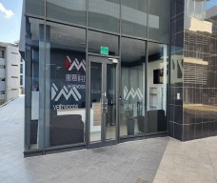
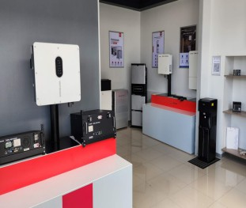
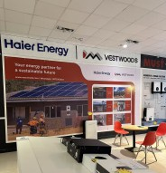
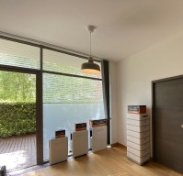
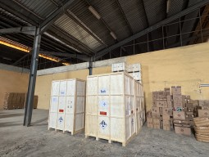
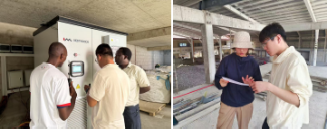
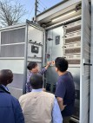
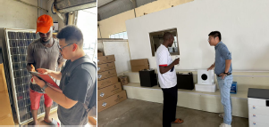
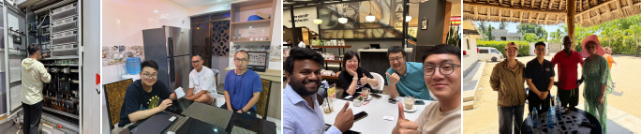
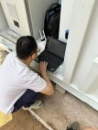
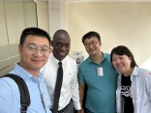
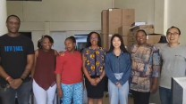
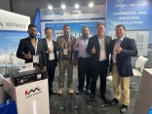
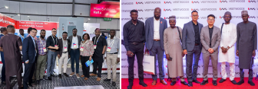
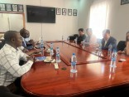
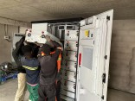

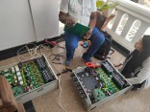
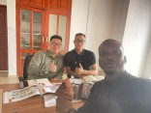
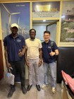
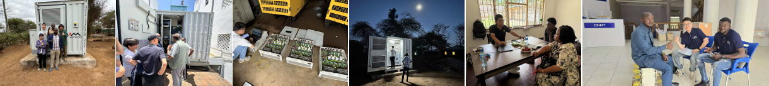
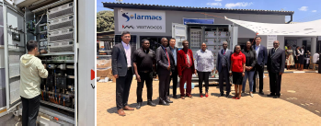
VESTWOODS Global Localization
Global Service Network : Delivering Highly - Efficient Localized Support
Technical Assurance: Overseas Expert Teams on Round - the - Clock Standby
Warehousing and Logistics: Fast Track Delivery Enabled by Pre-positioned Warehouse Stockpiles

Slide 12
02
R&D, Production Capacity
and Solutions

Slide 13



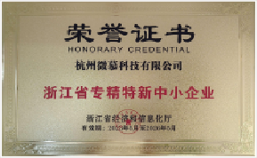
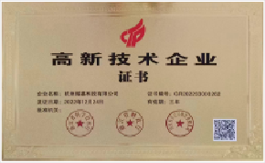
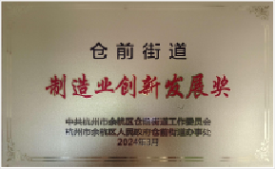


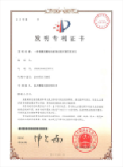
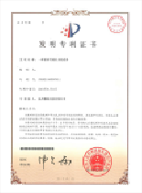
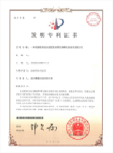

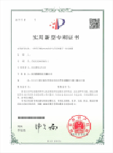
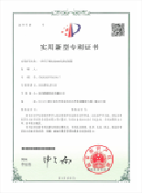





















VESTWOODS R&D Capability
Continuous Investment, Adhere to Technology
7% R&D investment
≥40% personnel with over 10 years of experience
≥18 years of experience in Li-ion battery industry
120+ domestic and international patents and
50+ software copyrights
30%
R&D Employee percentage
7%
R&D investment percentage
200+
Patents
IEC 63056
IEC62619
IEC62619
IEC62620
EN61000
UN38.3
50+
Global certifications
20+
Awards
30+
Global Whitelists
UL1973
IEC 62619
IEC 61000
IEC 62477
GB/T
ISO

Slide 14
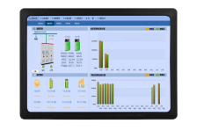







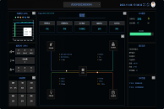
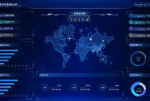
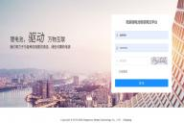







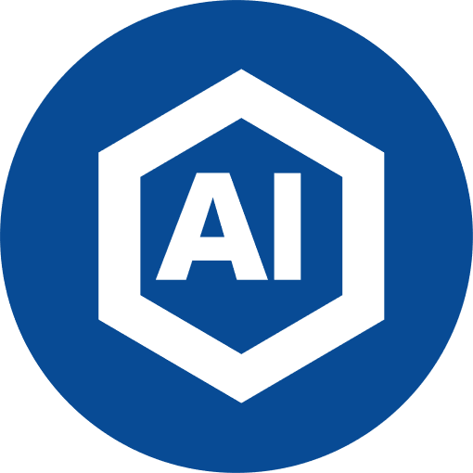
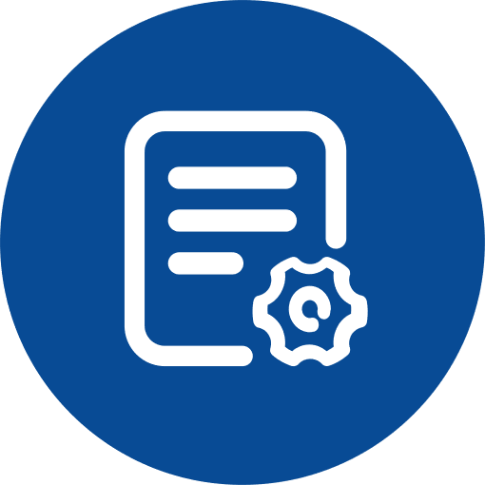
VESTWOODS Core Technology
Full Stack Self-development
DATA
Internet of Things
More stable, more efficient, more secure
Software
Hardware
BMS Battery Management
EMS Energy Management
Energy Storage
System Integration
Hardware Technology
High-stability circuit design
Software Technology
Multi-dimensional (Pack/Rack/Cluster) cell protection
- High-precision underlying algorithms for SOC, SOX, SOH, and SOE
- Full lifecycle management
- Predictive battery model algorithms
Cloud Platform
Rapid and stable data transmission, storage, and control solutions
Cloud-based intelligent early warning and cloud management
Big data analysis
Big data collection and analysis for cell and component lifespan prediction
Comprehensive access for multiple devices, sensors, and controllers
Flexible scalability to enable parallel operation of different energy storage cabinets
Self-learning control AI algorithm models with big data analytics for early risk warning in energy storage systems
Precise modeling of complex systems considering stochasticity and nonlinearity
Adaptability to diverse scenarios: photovoltaic, energy storage, diesel generation, integrated solar-storage-charging systems, etc.
Cloud-edge integrated deployment solutions
Component selection and analysis
Software and hardware development
CAE structural mechanics and thermal field simulation technologies
Safety design
Multi-mode state switching mechanisms
Battery Pack-level DC/DC topologies
Modular and customizable designs

Slide 15
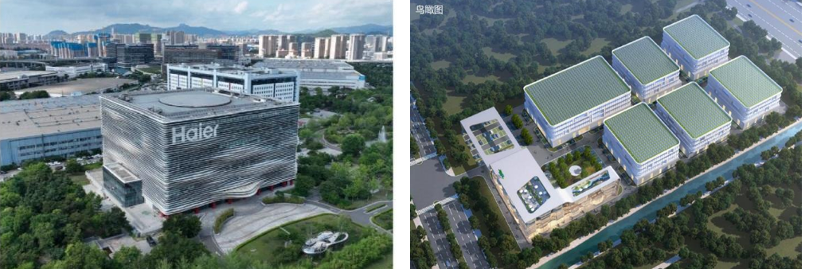

VESTWOODS Intelligent manufacturing
PV + ESS + PCS + EMS + EV Charger
-
Qingdao R&D Center
Technology Industry Park R&D Center: Focusing on the new energy industry ecosystem, it integrates 'research and development, manufacturing, production and supply, market sales, and achievement display' into one, creating an eco-friendly park for collaborative innovation across the entire industry chain.
Qingdao Manufacturing Center
Positioned as an intelligent energy controller IoT factory, the park covers a total area of 302 acres with a total investment of 6 billion yuan. It is an integrated park combining research, production, supply, sales, and exhibition, aiming to create the industry's first lighthouse factory for inverters.
Nantong Manufacturing Center
Covering an area of 40 acres, the modern production area spans 25,000 square meters, with an annual peak capacity exceeding 5 GWh. It is equipped with Industry 4.0 fully automated production lines, featuring an MES intelligent production management system, enabling full-process digital control from raw materials to finished products, empowering efficient and precise manufacturing.

Slide 16



VESTWOODS Customized multi-scenario solutions
We possess professional capabilities in providing customized solutions for multiple scenarios including “PV+ESS+X”
Industry: PV + Energy Storage + Cooling/Heating Solutions
Telecom Backup + UPS Scenario: Energy Storage / Battery + Communication Base
Station / Critical Equipment Load + Emergency Power / Instant Switching
Household: PV-Storage + (DC) Home Appliance Solutions
EV: PV + Energy Storage +
Charging Pile Solutions
Micro-grid: PV + Energy Storage - Local Load
Haier energy
BESS
Photovoltaic Power Plant Scenario:
PV + Grid-Tied / Feeding into the Grid
PV+ESS+X

Slide 17



WE WON’T PROVIDE THE CHEAPEST
WE WON’T PROVIDE THE MOST LUXURIOUS
WE PROVIDE THE BEST COST PERFORMANCE
WE USE ONLY CERTIFIED GRADE A BATTERY CELLS
WE PROVIDE THE BEST SAFETY & DURABILITY

